Slide 1
ELECTRONIC MAIL
One of the most popular Internet services is electronic mail (e-mail). The designers of the Internet probably never imagined the popularity of this application program. Its architecture consists of several components that we discuss in this chapter.
26.<number>

Slide 2

Figure 26.6 First scenario in electronic mail
26.<number>

Slide 3

Note
When the sender and the receiver of an e-mail are on the same system,
we need only two user agents.
26.<number>

Slide 4

Figure 26.7 Second scenario in electronic mail
26.<number>

Slide 5
Note
When the sender and the receiver of an e-mail are on different systems, we
need two UAs and a pair of
MTAs (client and server).
26.<number>

Slide 6

Figure 26.8 Third scenario in electronic mail
26.<number>

Slide 7
Note
When the sender is connected to the mail server via a LAN or a WAN,
we need two UAs and two pairs
of MTAs (client and server).
26.<number>

Slide 8

Figure 26.9 Fourth scenario in electronic mail
26.<number>

Slide 9

Figure 26.10 Push versus pull in electronic email
26.<number>

Slide 10
Note
When both sender and receiver are connected to the mail server via
a LAN or a WAN, we need two
UAs, two pairs of MTAs
and a pair of MAAs.
This is the most common situation today.
26.<number>

Slide 11

Figure 26.11 Services of user agent
26.<number>

Slide 12
Note
Some examples of command-driven user agents are mail, pine,
and elm.
26.<number>

Slide 13
Note
Some examples of GUI-based user agents are Eudora, Outlook, and Netscape.
26.<number>

Slide 14

Figure 26.12 Format of an e-mail
26.<number>

Slide 15

Figure 26.13 E-mail address
26.<number>

Slide 16

Figure 26.17 Commands and responses
26.<number>

Slide 17

Figure 26.18 Command format
26.<number>

Slide 18
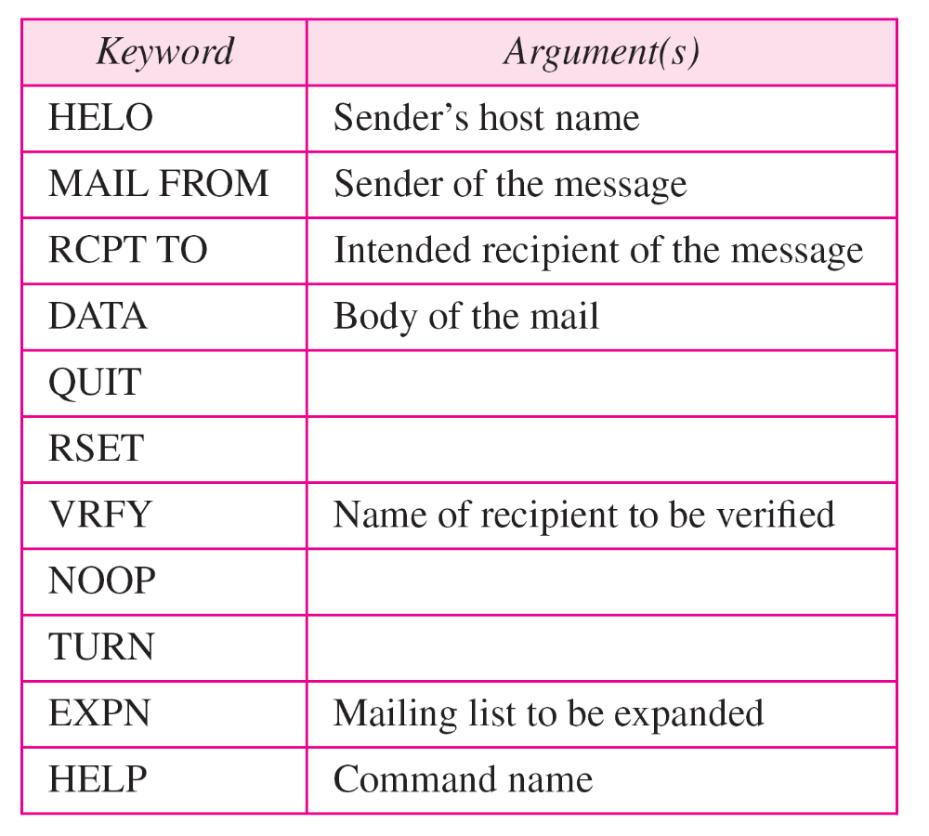
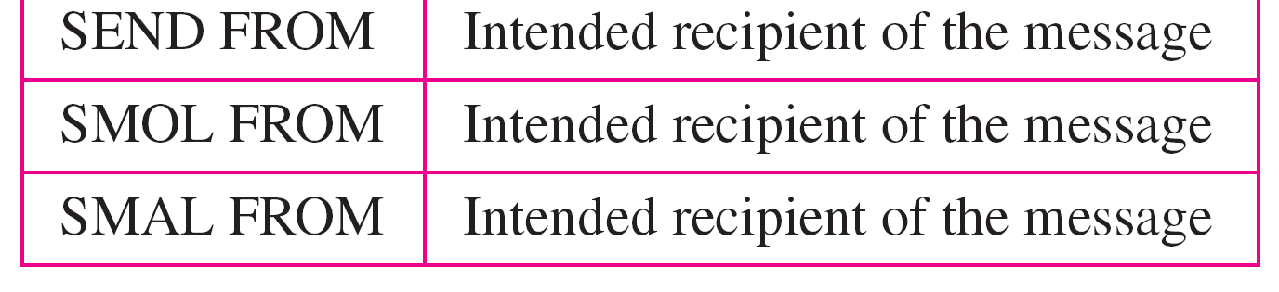
Table 26.7 Commands
26.<number>

Slide 19
NAME SPACE
To be unambiguous, the names assigned to machines must be carefully selected from a name space with complete control over the binding between the names and IP addresses.
25.<number>

Slide 20
DOMAIN NAME SPACE
In the postal system
  the country, state or province, city, street address and name of the addressee.
Hierarchical addressing ensures that there is NO confusion between the
    Street no. 2 in Azad Nagar in Jalandhar,
    Punjab and the Street no. 2 in Azad Nagar in Ambala, Haryana.
DNS works the same way.
25.<number>

Slide 21

Figure 25.1 Example of using the DNS service
25.<number>

Slide 22

Figure 25.2 Domain name space
25.<number>

Slide 23

Figure 25.3 Domain names and labels
25.<number>

Slide 24
Flat Name Space vs Hierarchical Name Space
Flat Name Space: A name is assigned to an address. A name in this space is a sequence of characters without structure.
Disadvantage: It cannot be used in a large system such as the Internet because it must be centrally controlled to avoid ambiguity and duplication.
Hierarchical Name Space: Each name is made of several parts. The first part can define the nature of the organization, the second part can define the name of an organization, the third part can define departments in the organization, and so on. In this case, the authority to assign and control the name spaces can be decentralized.
26.<number>

Slide 25
Fully Qualified Domain Name
If a label is terminated by a null string, it is called a FQDN.
An FQDN is a domain name that contains the full name of a host.
It contains all labels, from the most specific to the most general, that uniquely define the name of the host.
For example, the domain name challenger.ate.tbda.edu
26.<number>

Slide 26
Partially Qualified Domain Name
If a label is not terminated by a null string, it is called a PQDN.
A PQDN starts from a node, but it does not reach the root.
It is used when the name to be resolved belongs to the same site as the client.
Here the resolver can supply the missing part, called the suffix, to create an FQDN. For example, if a user at the jhda.edu. site wants to get the IP address of the challenger computer, he or she can define the partial name
challenger The DNS client adds the suffix atc.jhda.edu. before passing the address to the DNS server.
26.<number>

Slide 27
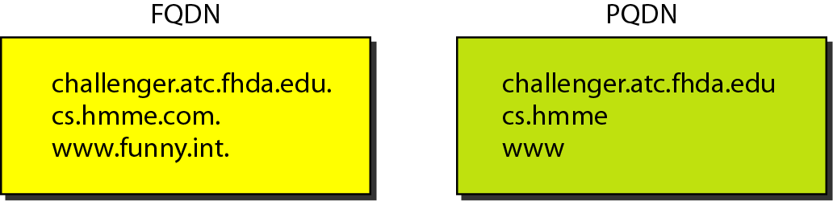
Figure 25.4 FQDN and PQDN
25.<number>

Slide 28

Figure 25.5 Domains
25.<number>

Slide 29
DISTRIBUTION OF NAME SPACE
The information contained in the domain name space must be stored. However, it is very inefficient and also unreliable to have just one computer store such a huge amount of information. In this section, we discuss the distribution of the domain name space.
25.<number>

Slide 30

Hierarchy of name servers
25.<number>

Slide 31

26.<number>

Slide 32

Zones and domains
25.<number>

Slide 33
Note
A primary server loads all information from the disk file; the secondary server
loads all information from
the primary server.
When the secondary downloads
information from the primary, it is called zone transfer.
25.<number>

Slide 34
DNS IN THE INTERNET
DNS is a protocol that can be used in different platforms. In the Internet, the domain name space (tree) is divided into three different sections:
generic domains
country domains
inverse domain.
25.<number>

Slide 35

DNS IN THE INTERNET
25.<number>

Slide 36

Generic domains
25.<number>

Slide 37

Table 25.1 Generic domain labels
25.<number>

Slide 38

Figure 25.10 Country domains
25.<number>

Slide 39

Figure 25.11 Inverse domain
The inverse domain is used to map an address to a name.
When a server has received a request from a client to do a task.
Server has a file that contains a list of authorized clients, only the IP address of the client (extracted from the received IP packet) is listed.
Server asks its resolver to send a query to the DNS server to map an address to a name to determine if the client is on the authorized list.
This type of query is called an inverse or pointer (PTR) query.
25.<number>

Slide 40
RESOLUTION
Mapping a name to an address or an address to a name is called name-address resolution.
25.<number>

Slide 41

Figure 25.12 Recursive resolution
25.<number>

Slide 42

Figure 25.13 Iterative resolution
25.<number>

